Slide 1



NHS GP Registrations
View in Power BI
Last data refresh:
10/17/2021 6:39:44 AM UTC
Downloaded at:
10/17/2021 3:33:01 PM UTC

Slide 2
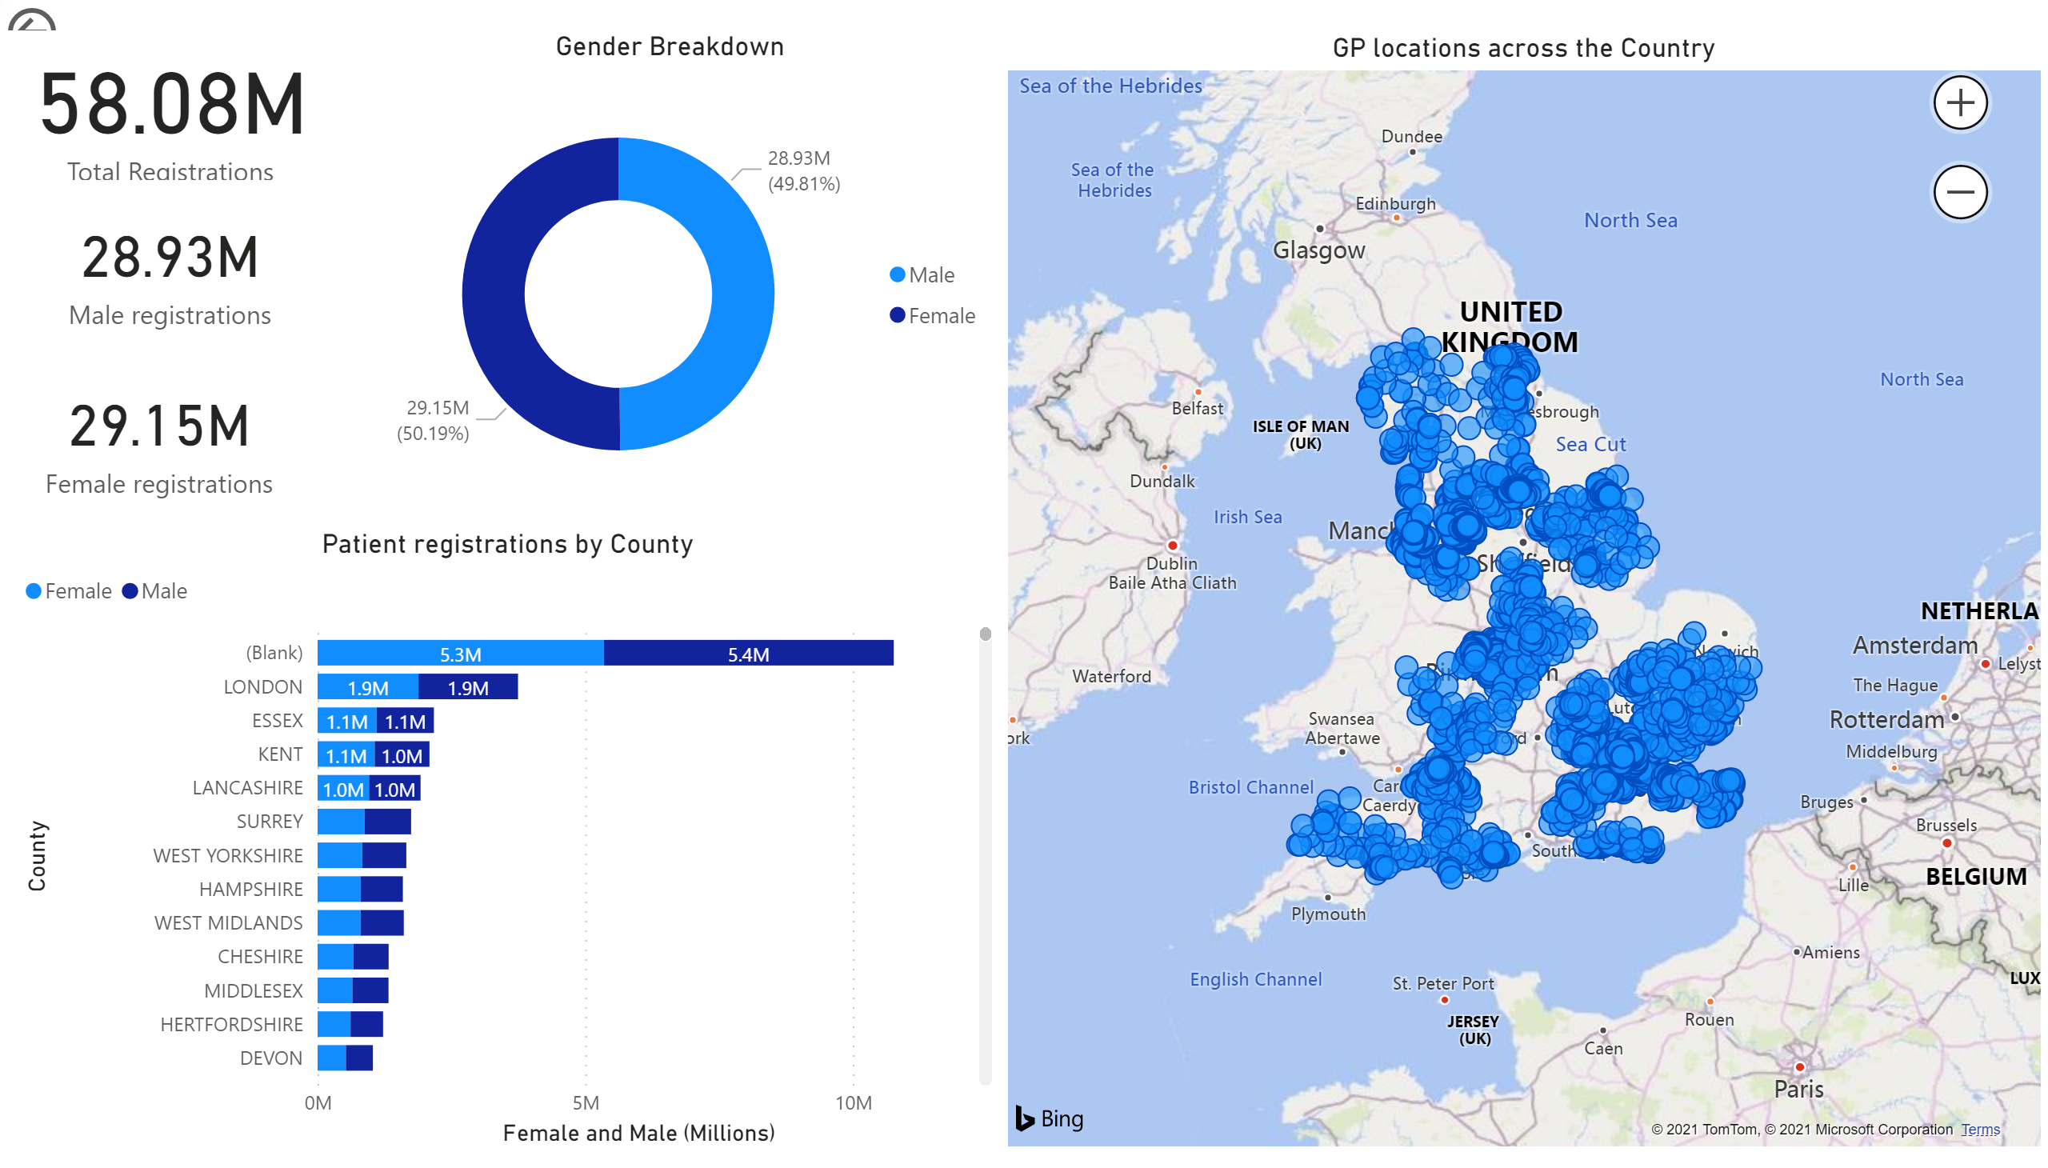
Page 1
Notes:
GP locations across the Country
No alt text provided.
actionButton
No alt text provided.
Total registrations
Total registrations
Patient registrations by County
No alt text provided.
Gender Breakdown
No alt text provided.
card
No alt text provided.
card
No alt text provided.

